Slide 1
Space Time Card
Preliminary Detailed Design Phase
Eva Czukkermann, Ian Dolfi, Nsadhu Muyinda, Drew Schacke, Luke Schrom, Tanner Smith

Slide 2
Overview
Feedback from Last Review
Individual and Team Vision
Feasibility: Analysis, Simulations
Feasibility: Prototyping
Drawing, Schematics, Diagrams
Bill of Materials (BOM)
Test Plans
System Design and Flowcharts/System Block Diagram
Risk Assessment
Open Items
Project Management
Goals for Next Phase
Notes:
Tanner

Slide 3
Feedback from Last Review
Using both CSAC and SiT5356
Using CAN to interface with the motherboard
Using SA45 chip
Notes:
Eva

Slide 4
Individual and Team Vision:
Planned: Includes revising component selections, development of a BOM, proposing development kits, testbenches, and ordering long lead time items. It was identified that deciding upon and ordering longer-lead time items was of utmost priority.
Accomplished: Ordered long-lead items, high level system design was considered and defined as simple block diagrams. The hold over drift characteristics of the various SiT branded TCXO were explored. The feasibility of the timecard was explored through the use of the MATLAB [Simulink].
Notes:
Tanner

Slide 5
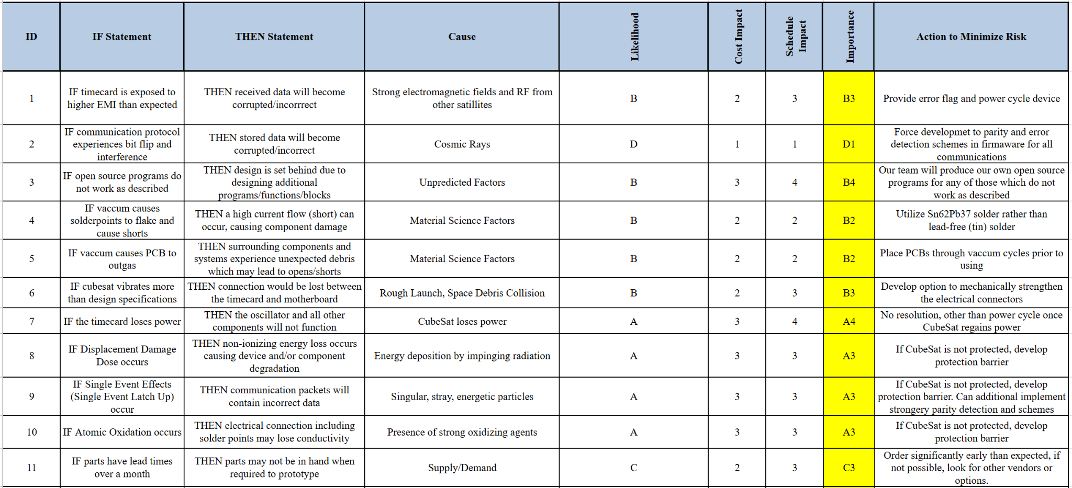
Risk Assessment:
Notes:
Drew

Slide 6
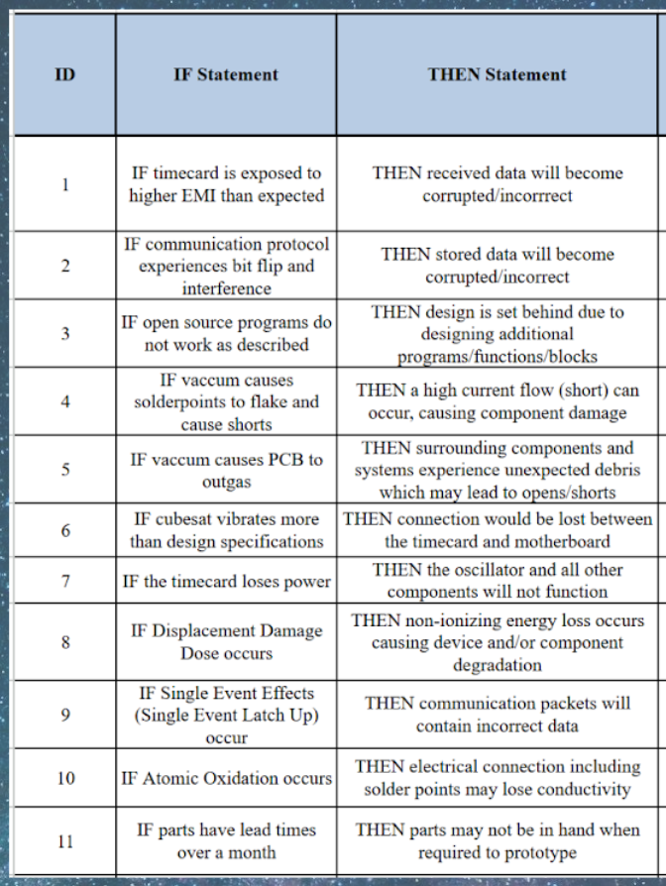
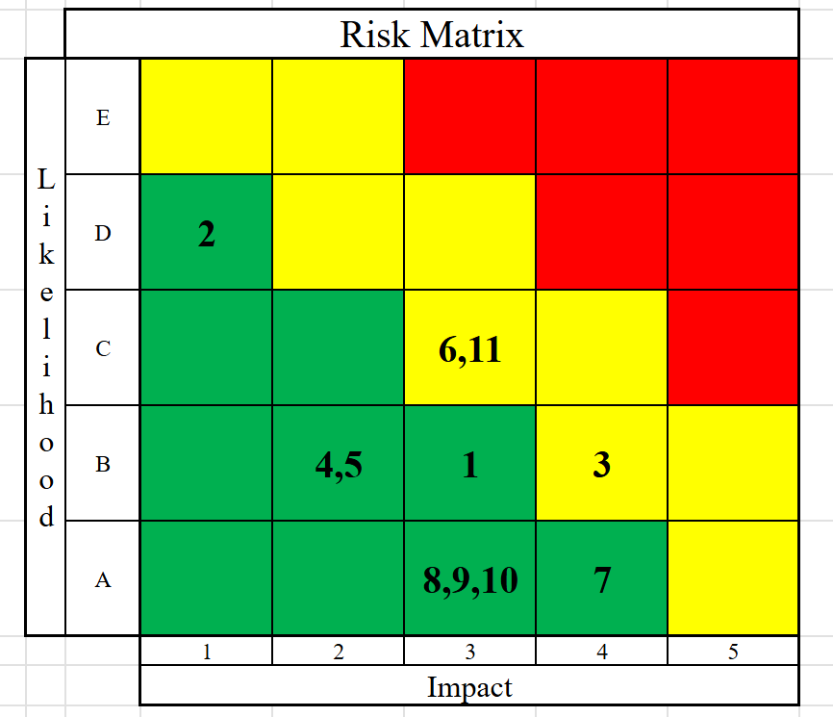
Notes:
Drew

Slide 7
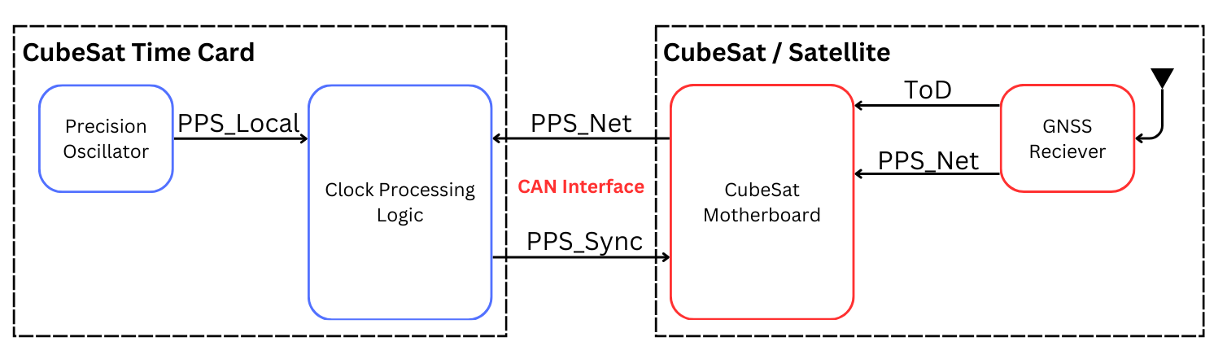
System Design Flowchart: High Level
Notes:
Tanner

Slide 8
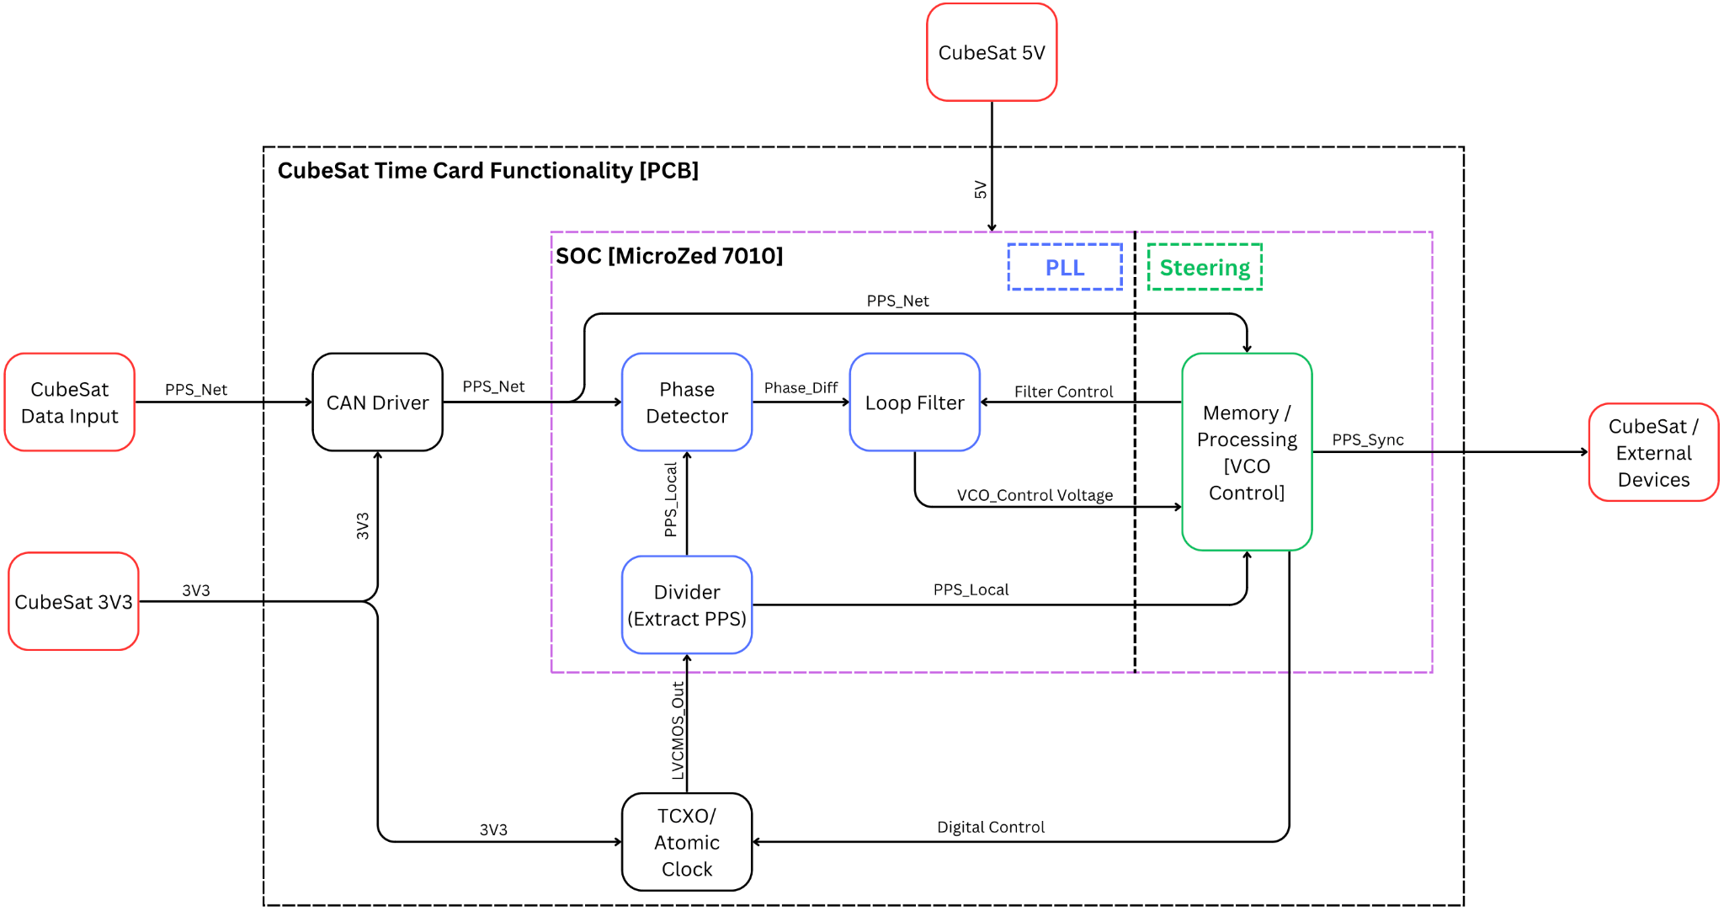
System Design Flowchart: Board Functionality
Notes:
Tanner

Slide 9
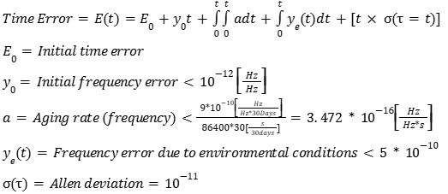




Feasibility: Holdover Specifications
The SA-45 CSAC datasheet does not directly give holdover specifications, but we can calculate expected holdover error from the given values
No corrections
If we can fully correct for aging and environment

Slide 10
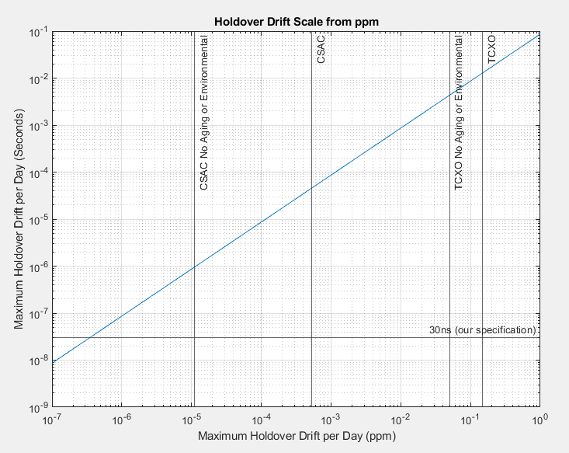
Feasibility: Holdover Specifications
Comparison of holdover specification in ppm to maximum time drift in seconds. The range we expect to fall within is between “CSAC” and “CSAC No Aging or Environmental” for the SA-45 or between “TCXO” and “TCXO No Aging or Environmental” for the SiT5356

Slide 11
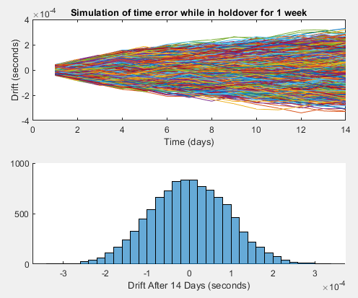
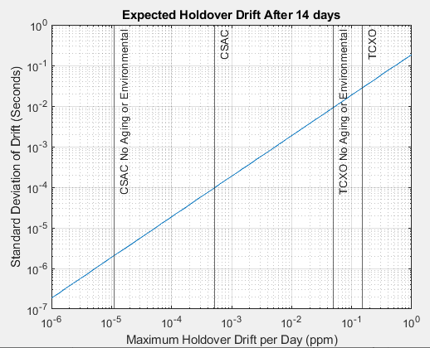
Feasibility: Holdover Specifications
Simulation snippet at 0.5ppb
Standard deviation of time drift after 2 weeks of holdover

Slide 12
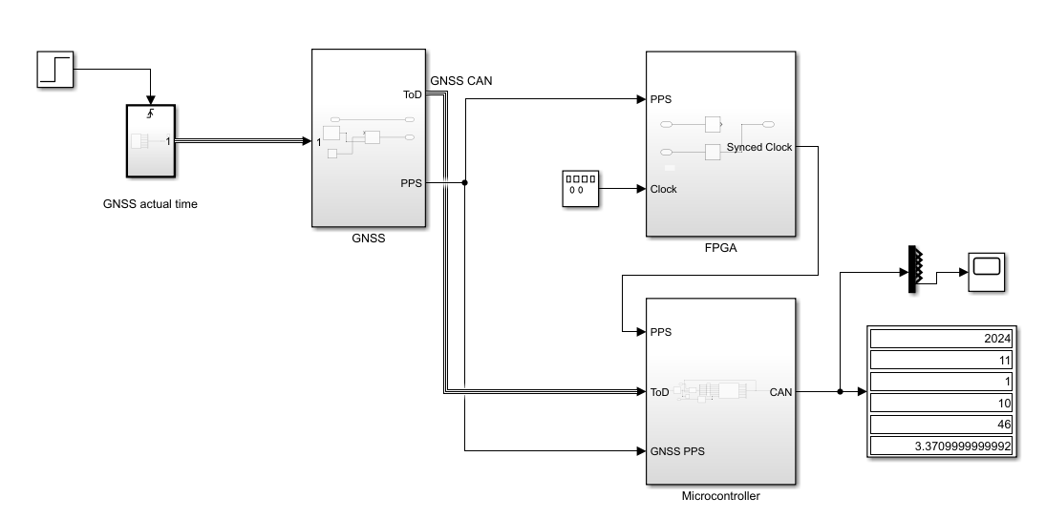
System Model
Notes:
Luke

Slide 13
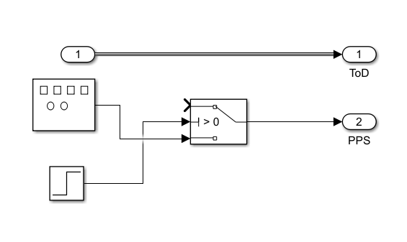
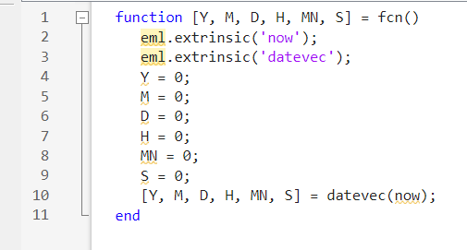
GNSS
Notes:
Luke

Slide 14
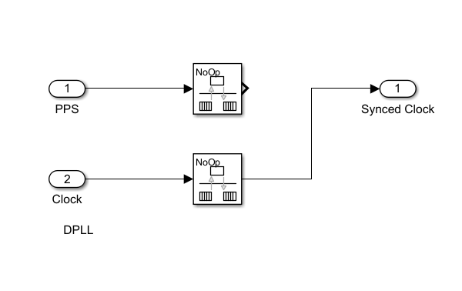
FPGA
Notes:
Luke

Slide 15
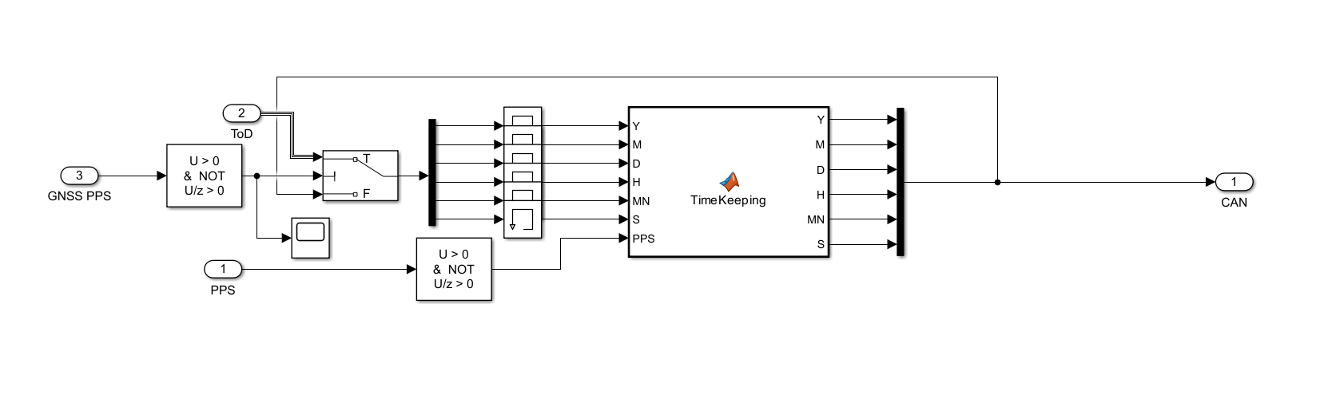
Microcontroller
Notes:
Luke

Slide 16
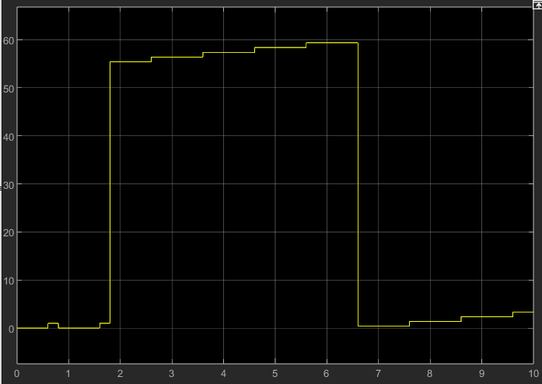
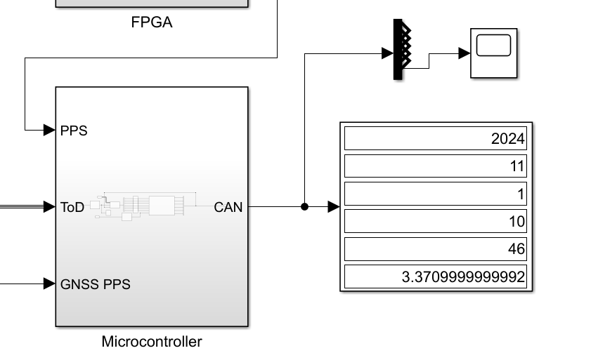
Timing Management
Notes:
Luke

Slide 17
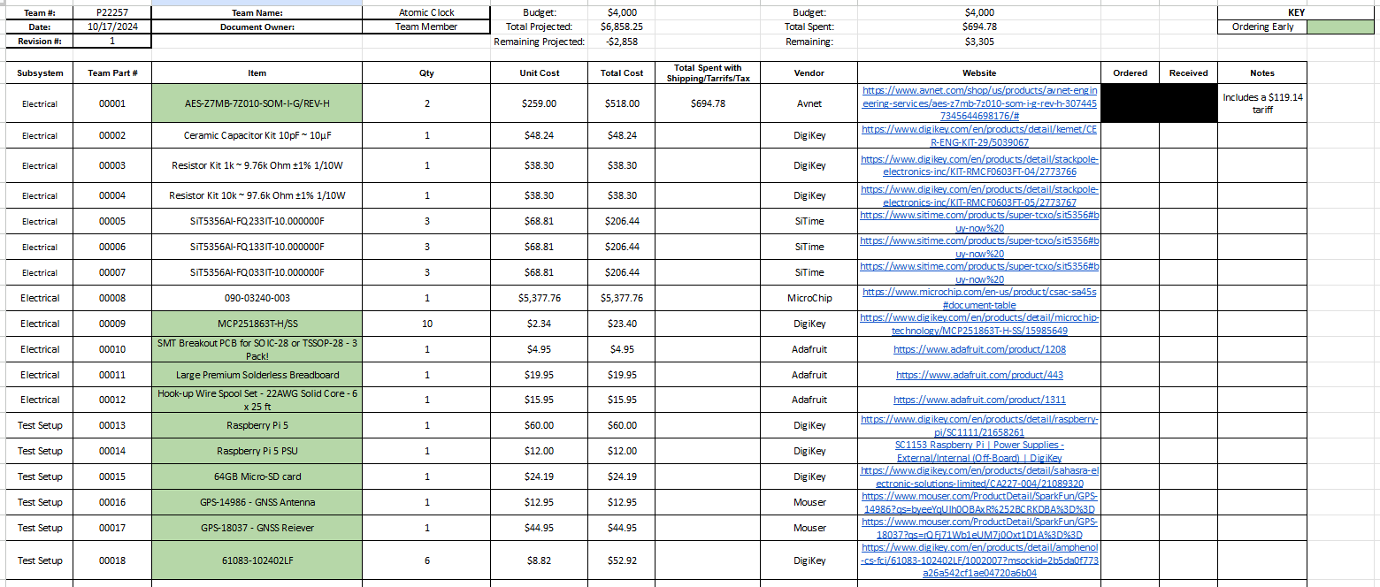
Bill of Materials (BOM)
Notes:
Eva

Slide 18
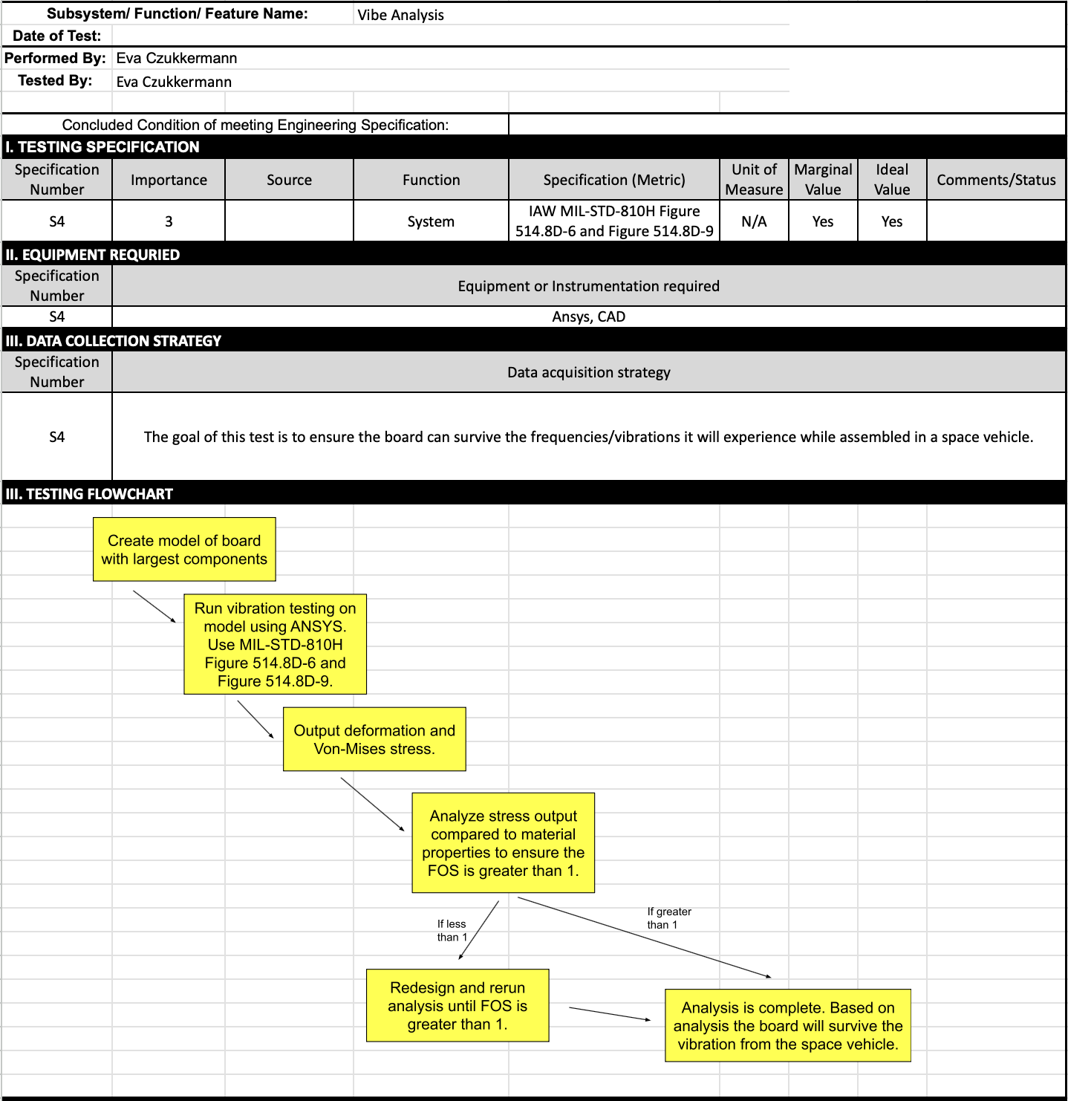
Test Plan: Vibe Analysis
Notes:
Nsadhu

Slide 19
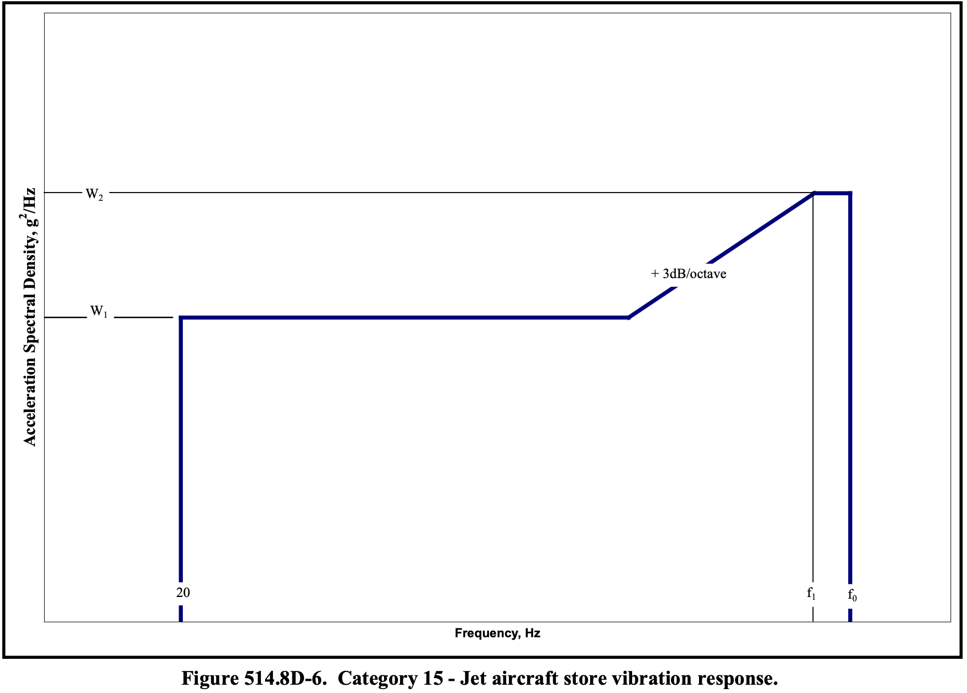
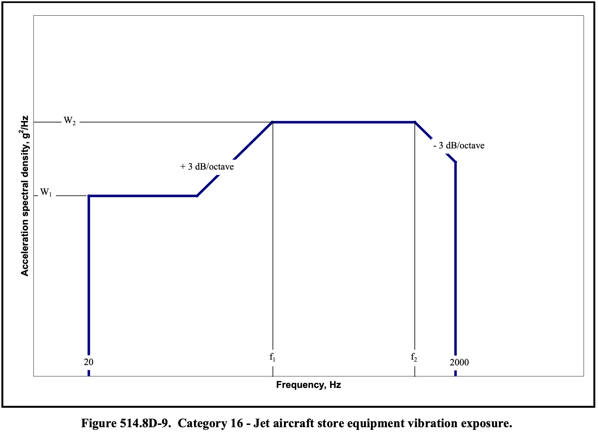
Vibe Analysis Specifications: MIL-STD-810H
Notes:
Nsadhu

Slide 20
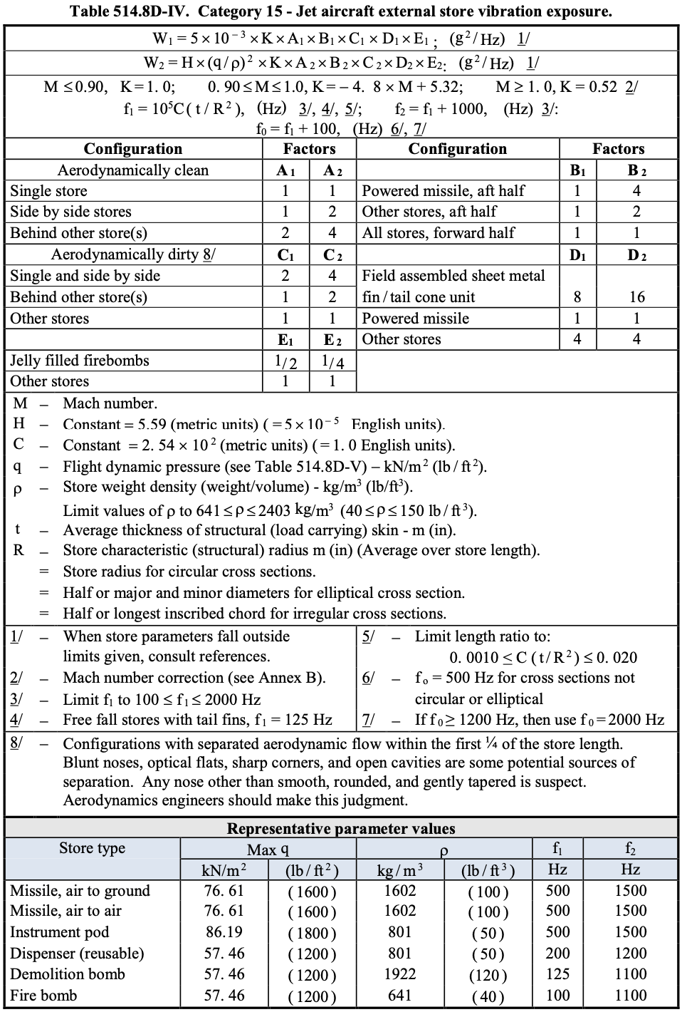
Notes:
Nsadhu

Slide 21
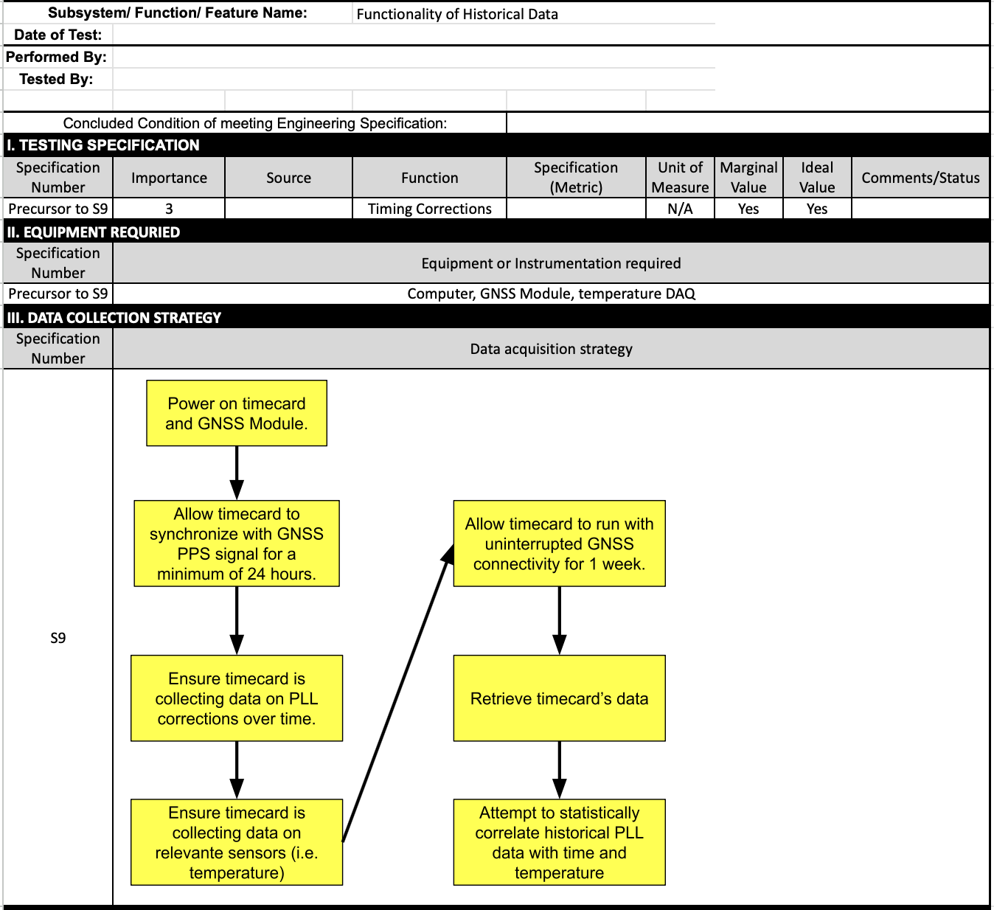
Test Plan: Historical Data
Capture
Test plan to verify functionality of historical data capture. This allows us to create statistical models to actively steer the oscillator while in holdover to reduce phase error.
Not directly related to ER.

Slide 22
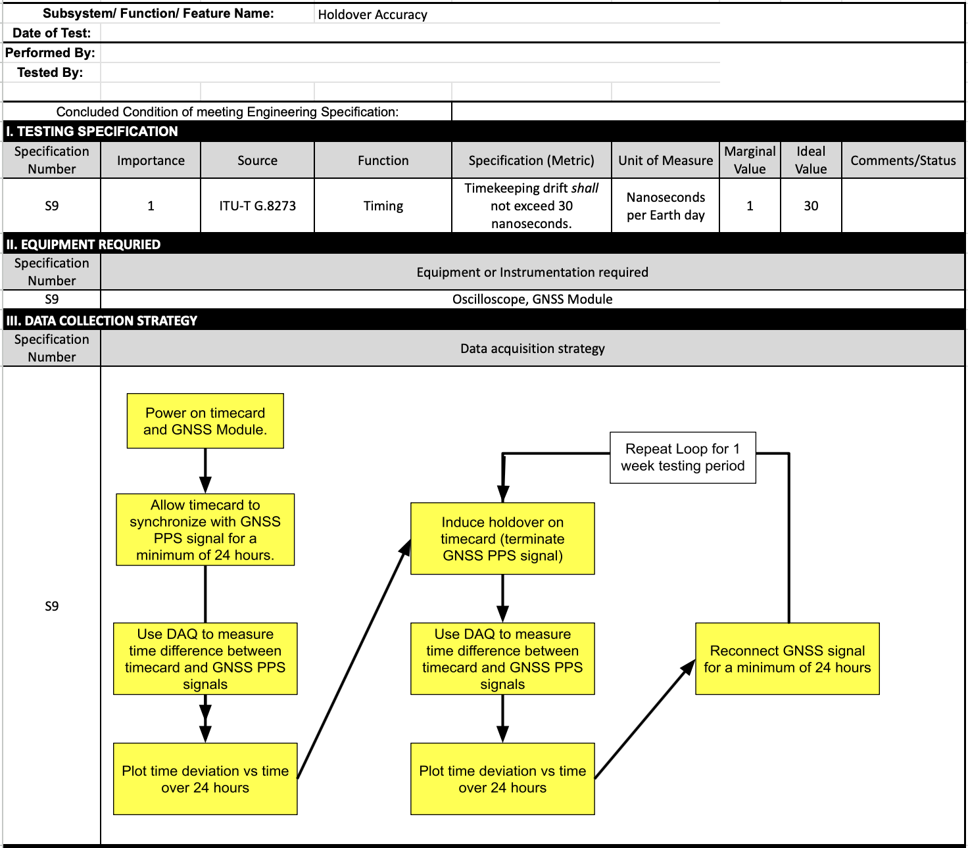
Test Plan: Holdover
Accuracy (ER 9)
Test plan to verify the accuracy of the timecard while in holdover.

Slide 23
Open Items
Meta’s timecard can adjust its time from up to 2 GNSS sources which can be configured independently.
The timecard switches to the next source when one fails or switches to the GNSS receiver with a more stable signal.
This can mitigate jamming and spoofing by switching to another source or the oscillator when disruptions are detected.
Time of Day(ToD) output pulse requirements and expectations.
Notes:
Ian

Slide 24
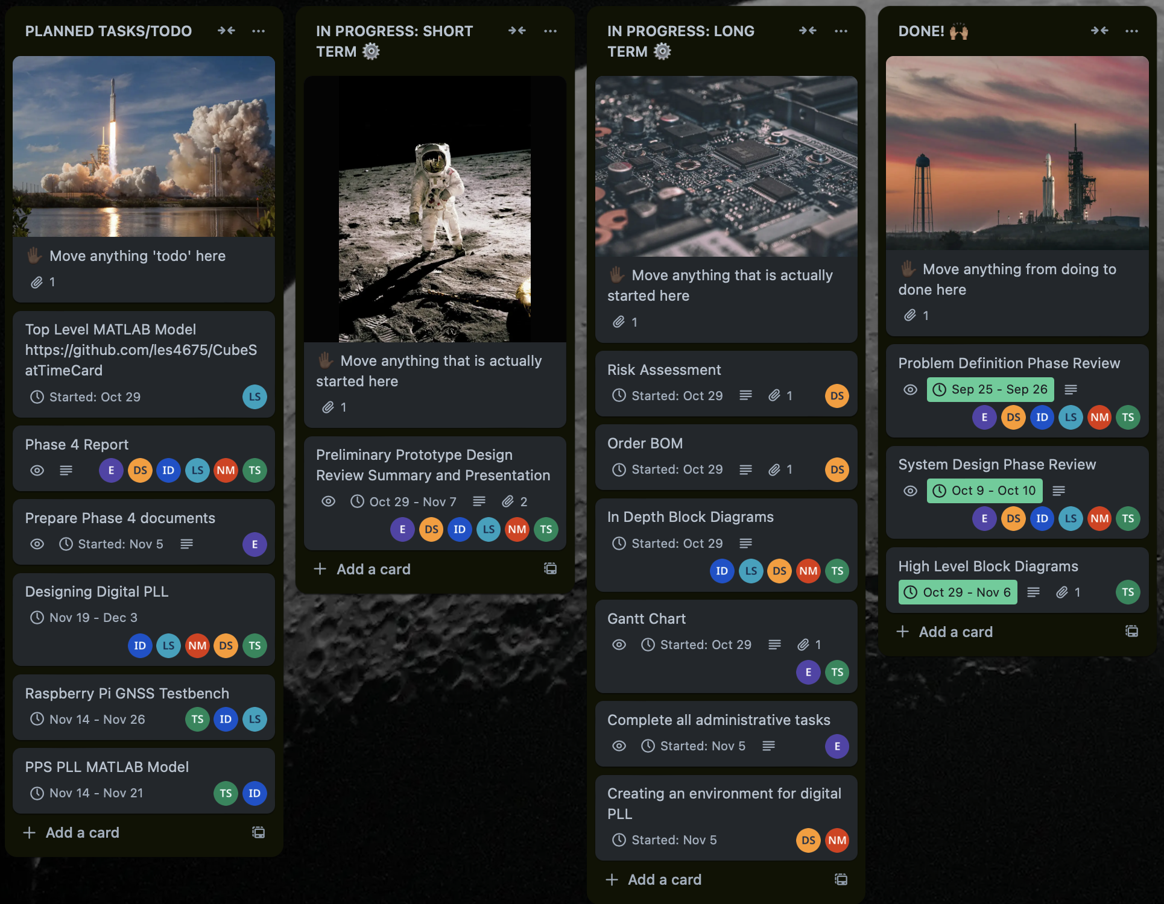
Project Management - Trello
Trello Board
Notes:
Eva

Slide 25
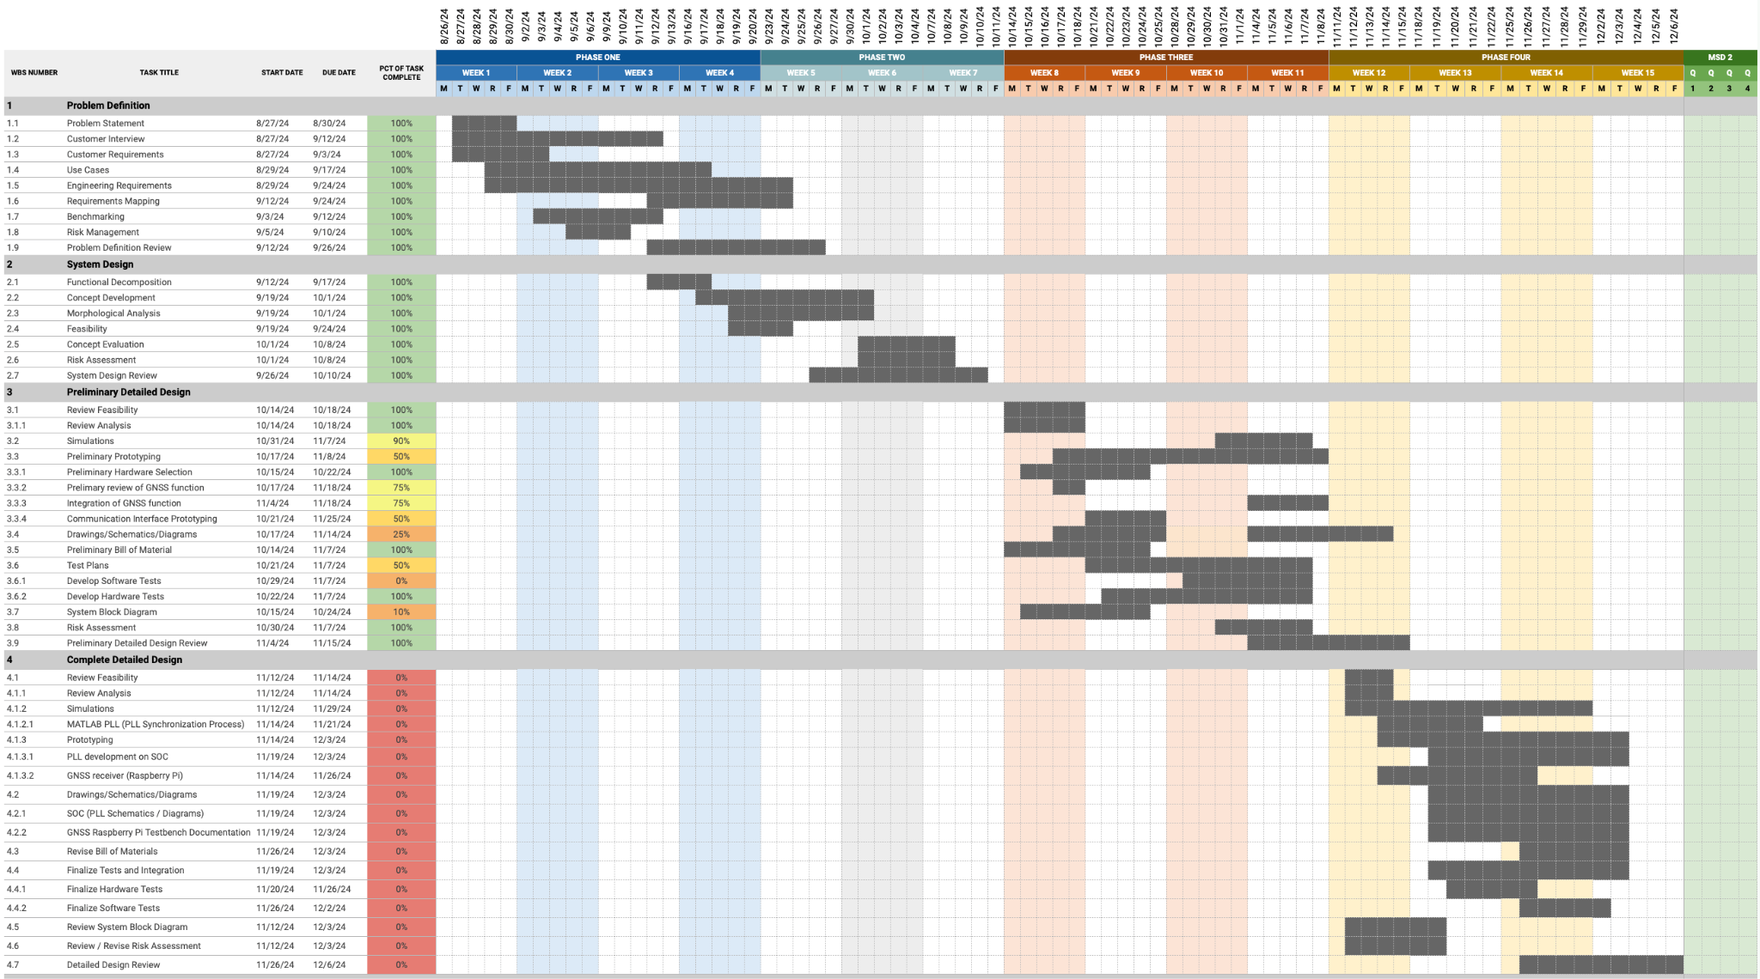
Gantt Chart
Personal Assignments can be viewed within summary reports.
Gantt Chart
Notes:
Tanner

Slide 26
Goals for Next Phase
Implement Digital PLL onboard MicroZed 7010 SOC.
Interfacing between MicroZed 7010 [SOC] and multiple TCXO / Atomic Clock breakout boards.
Benchmarking / Analysis on MATLAB for PLL design.
Development of GNSS Raspberry Pi testbench.
In short, produce a prototype that generates a PPS from TCXO / Atomic Clock and synchronize with externally produced PPS (From GNSS) through the use of a developed digital PLL.
Notes:
Tanner

